Slide 1
Machine Learning
Machine Learning Introduction to Machine Learning by Kumar Anurupam is licensed under a Creative Commons Attribution-4.0 International License.
Artificial Neural Networks – CNN - IV
CS 3104 Fall 2019
Lecture Slides by Kumar Anurupam

Slide 2
Learning Objectives
After completion of today’s session you will be able to:
Illustrate the concept of pooling.
Describe the optimization of CNN.
Explain the concept of flattening and Softmax function.

Slide 3
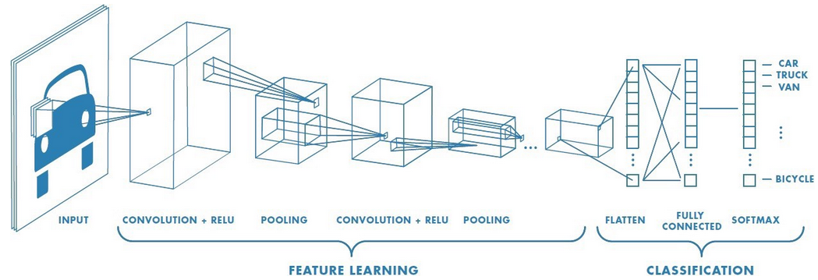
CNN recap

Slide 4
Pooling
It draws inspiration from layers of visual cortex which operate at the higher level.
It helps to achieve:
Location Invariant
Scale Invariant
Rotational Invariant
It can use various approaches like:
Max-Pooling
Avg/Mean Pooling etc.

Slide 5
CNN Optimization
The best way to optimize the CNN is through the concept of back propagation.
Since, Backpropagation is dependent on the calculation of derivatives so, the layers used in CNN must be differentiable.
Convolutional layer
Max-Pooling Layer

Slide 6
Flatenning
Flattening is converting the data into a 1-dimensional array for inputting it to the next layer.
We flatten the output of the convolutional layers to create a single long feature vector.
And it is connected to the final classification model, which is called a fully-connected layer.

Slide 7
Softmax function
Recall that logistic regression produces a decimal between 0 and 1.0. For example, a logistic regression output of 0.8 from an email classifier suggests an 80% chance of an email being spam and a 20% chance of it being not spam.
Softmax extends this idea into a multi-class world. That is, Softmax assigns decimal probabilities to each class in a multi-class problem. Those decimal probabilities must add up to 1.0. This additional constraint helps training converge more quickly than it otherwise would.

Slide 8
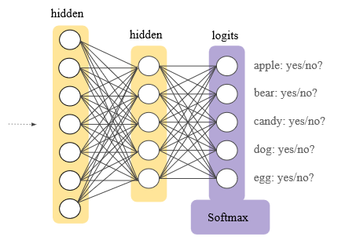
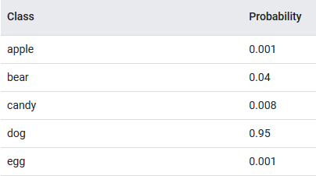
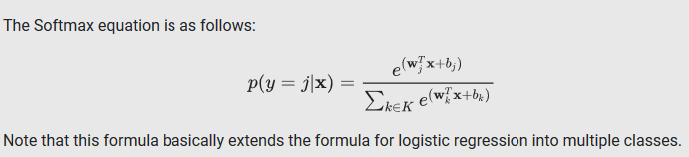
Softmax function contd…

Slide 9
References
[1]https://www.quora.com/How-are-the-parameters-of-max-pooling-represented-in-the-weights-nodes-of-a-neural-network
[2]https://developers.google.com/machine-learning/crash-course/multi-class-neural-networks/softmax

Slide 10
Thanks

